Slide 1
IFC-RFC Overview

Slide 2
What is it
AI assisted system for identifying, commenting and resolving all technical and standards issues contributing to IFC5.
Core: a register of RFC (Request for Comment) docs.
RFCs files
Multiple means for commenting and adding
Built in both github and google docs so we can test both.
A prioritization proposal
Python scripts for updated, processing, synchronizing

Slide 3
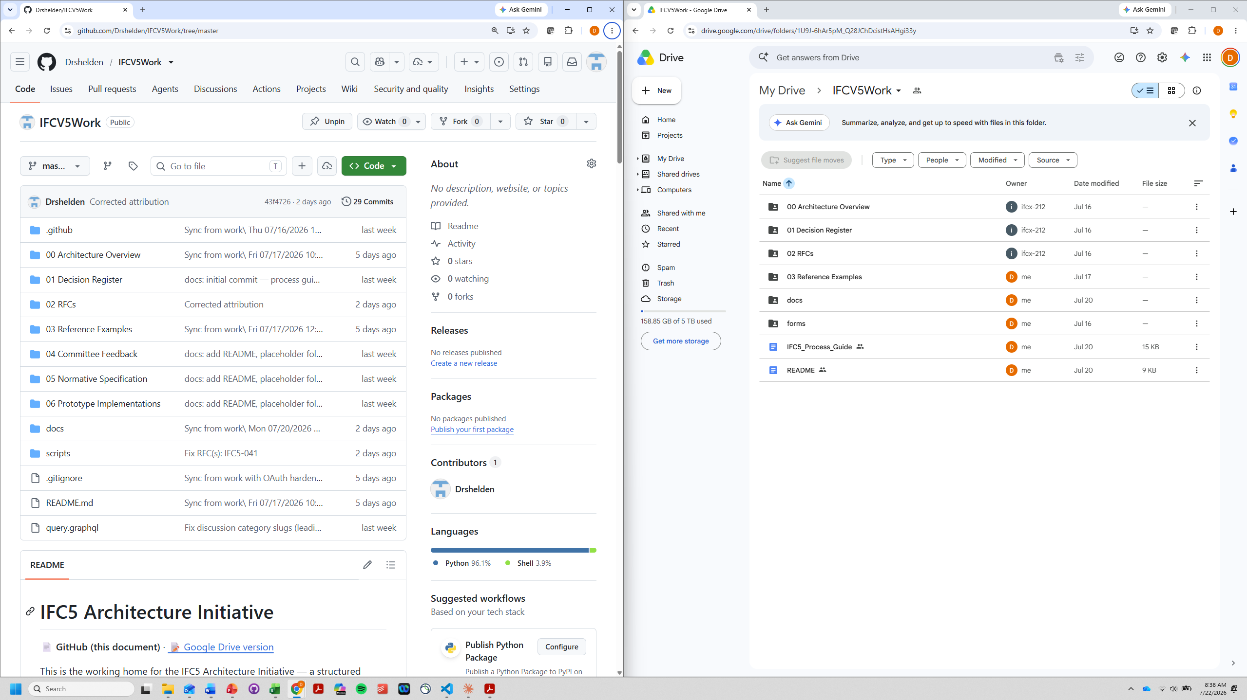

Slide 4
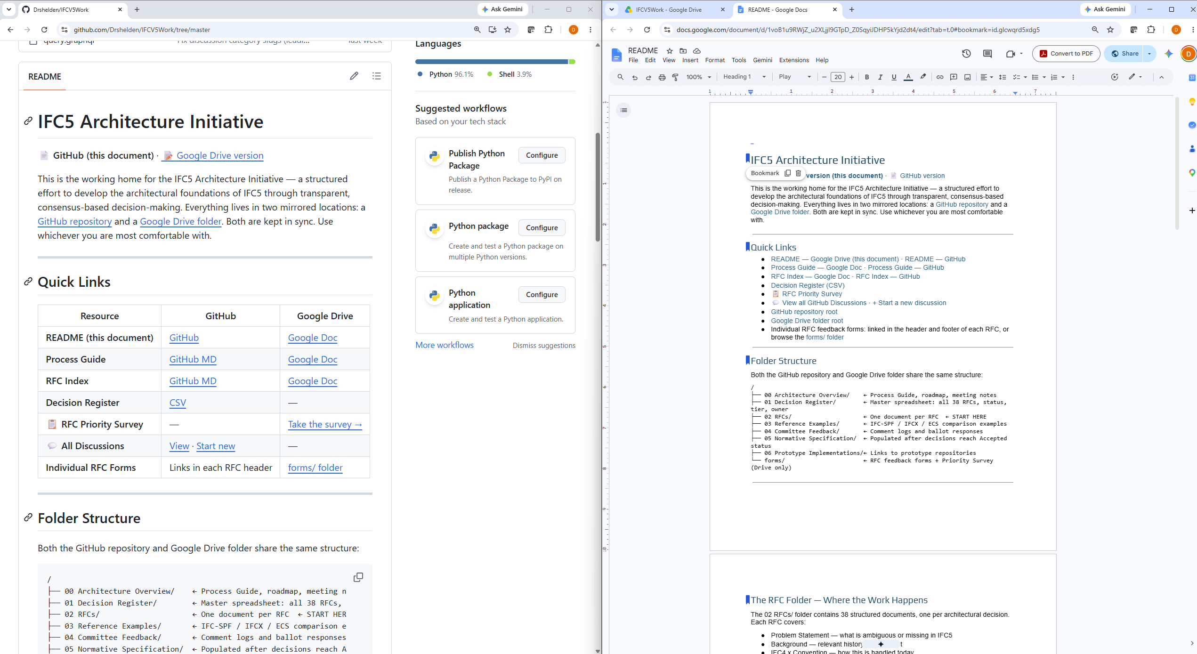

Slide 5
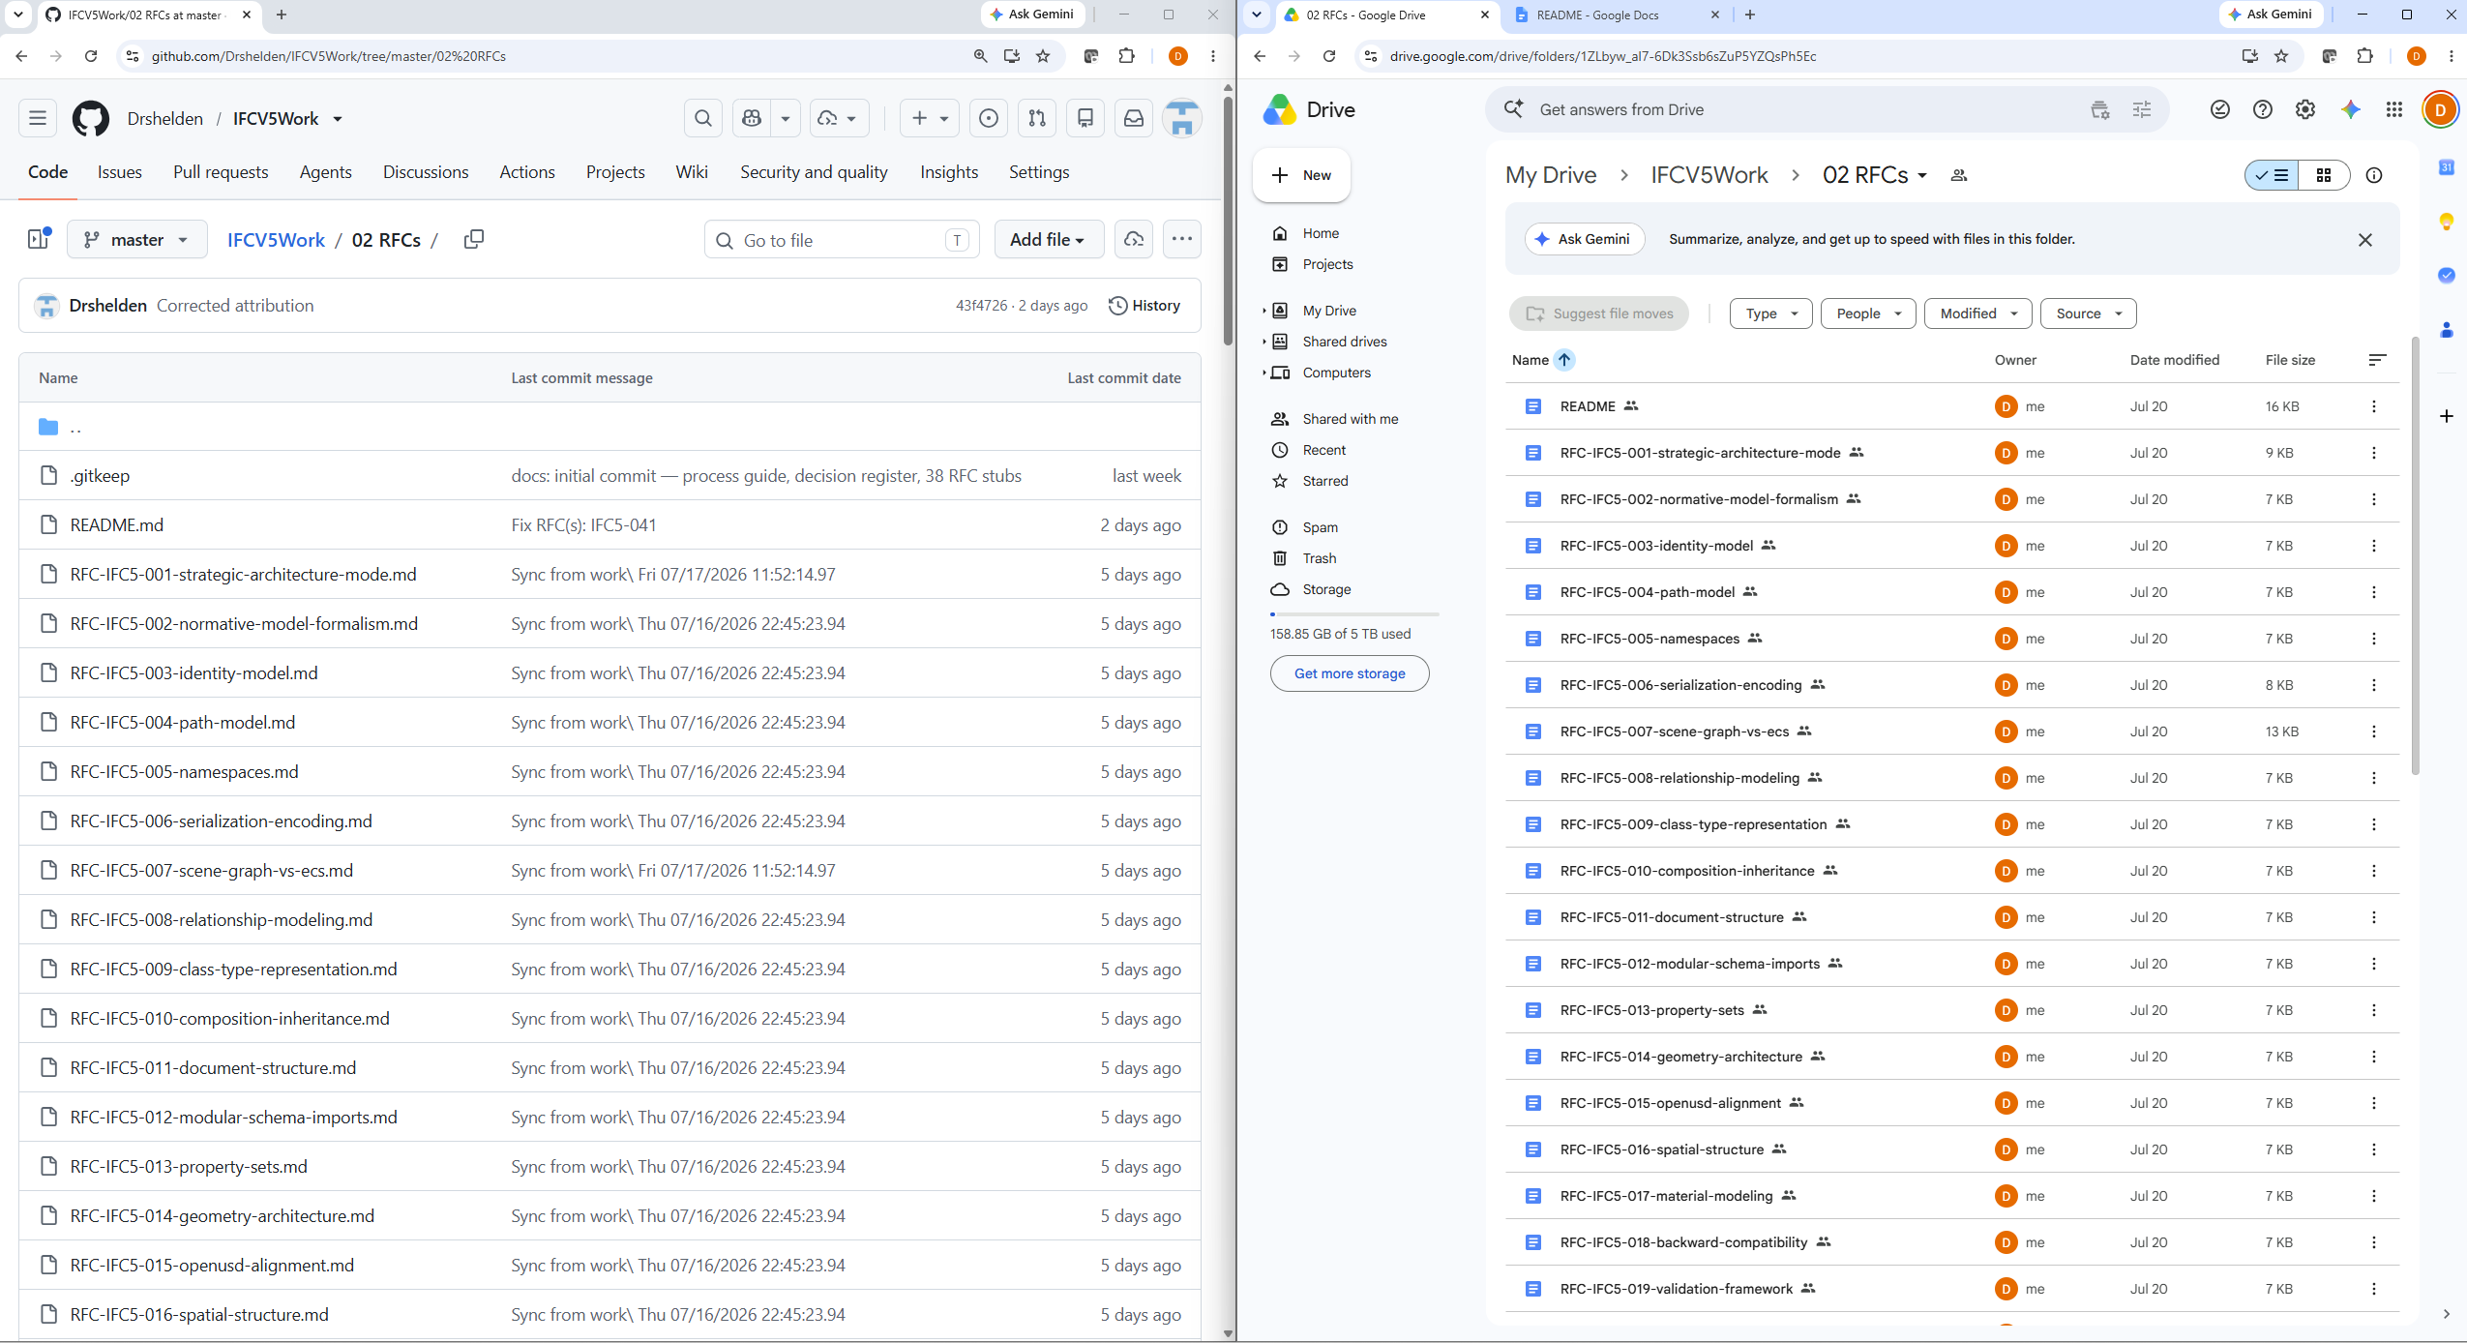

Slide 6
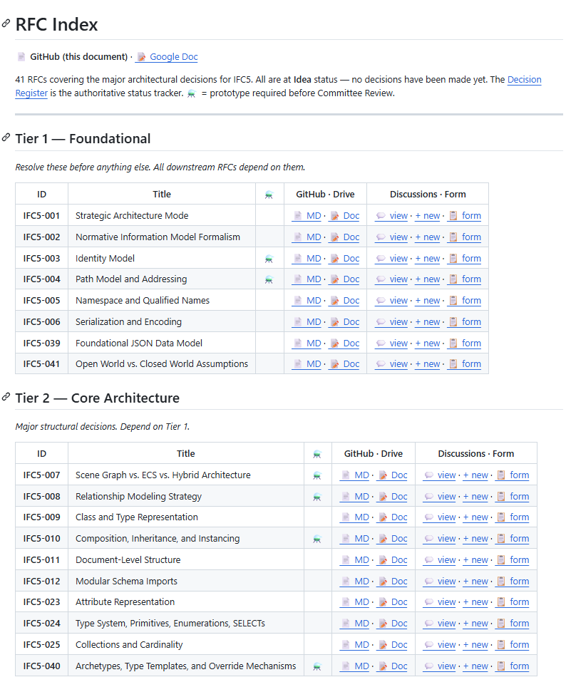
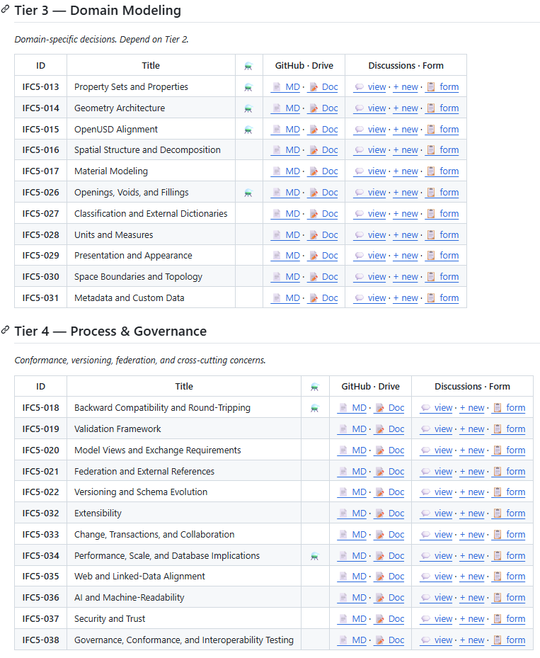

Slide 7
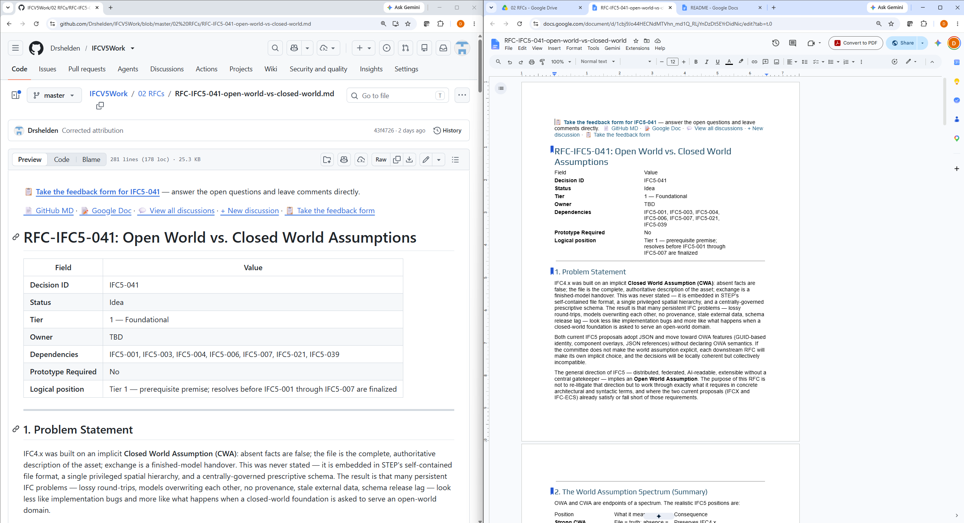

Slide 8
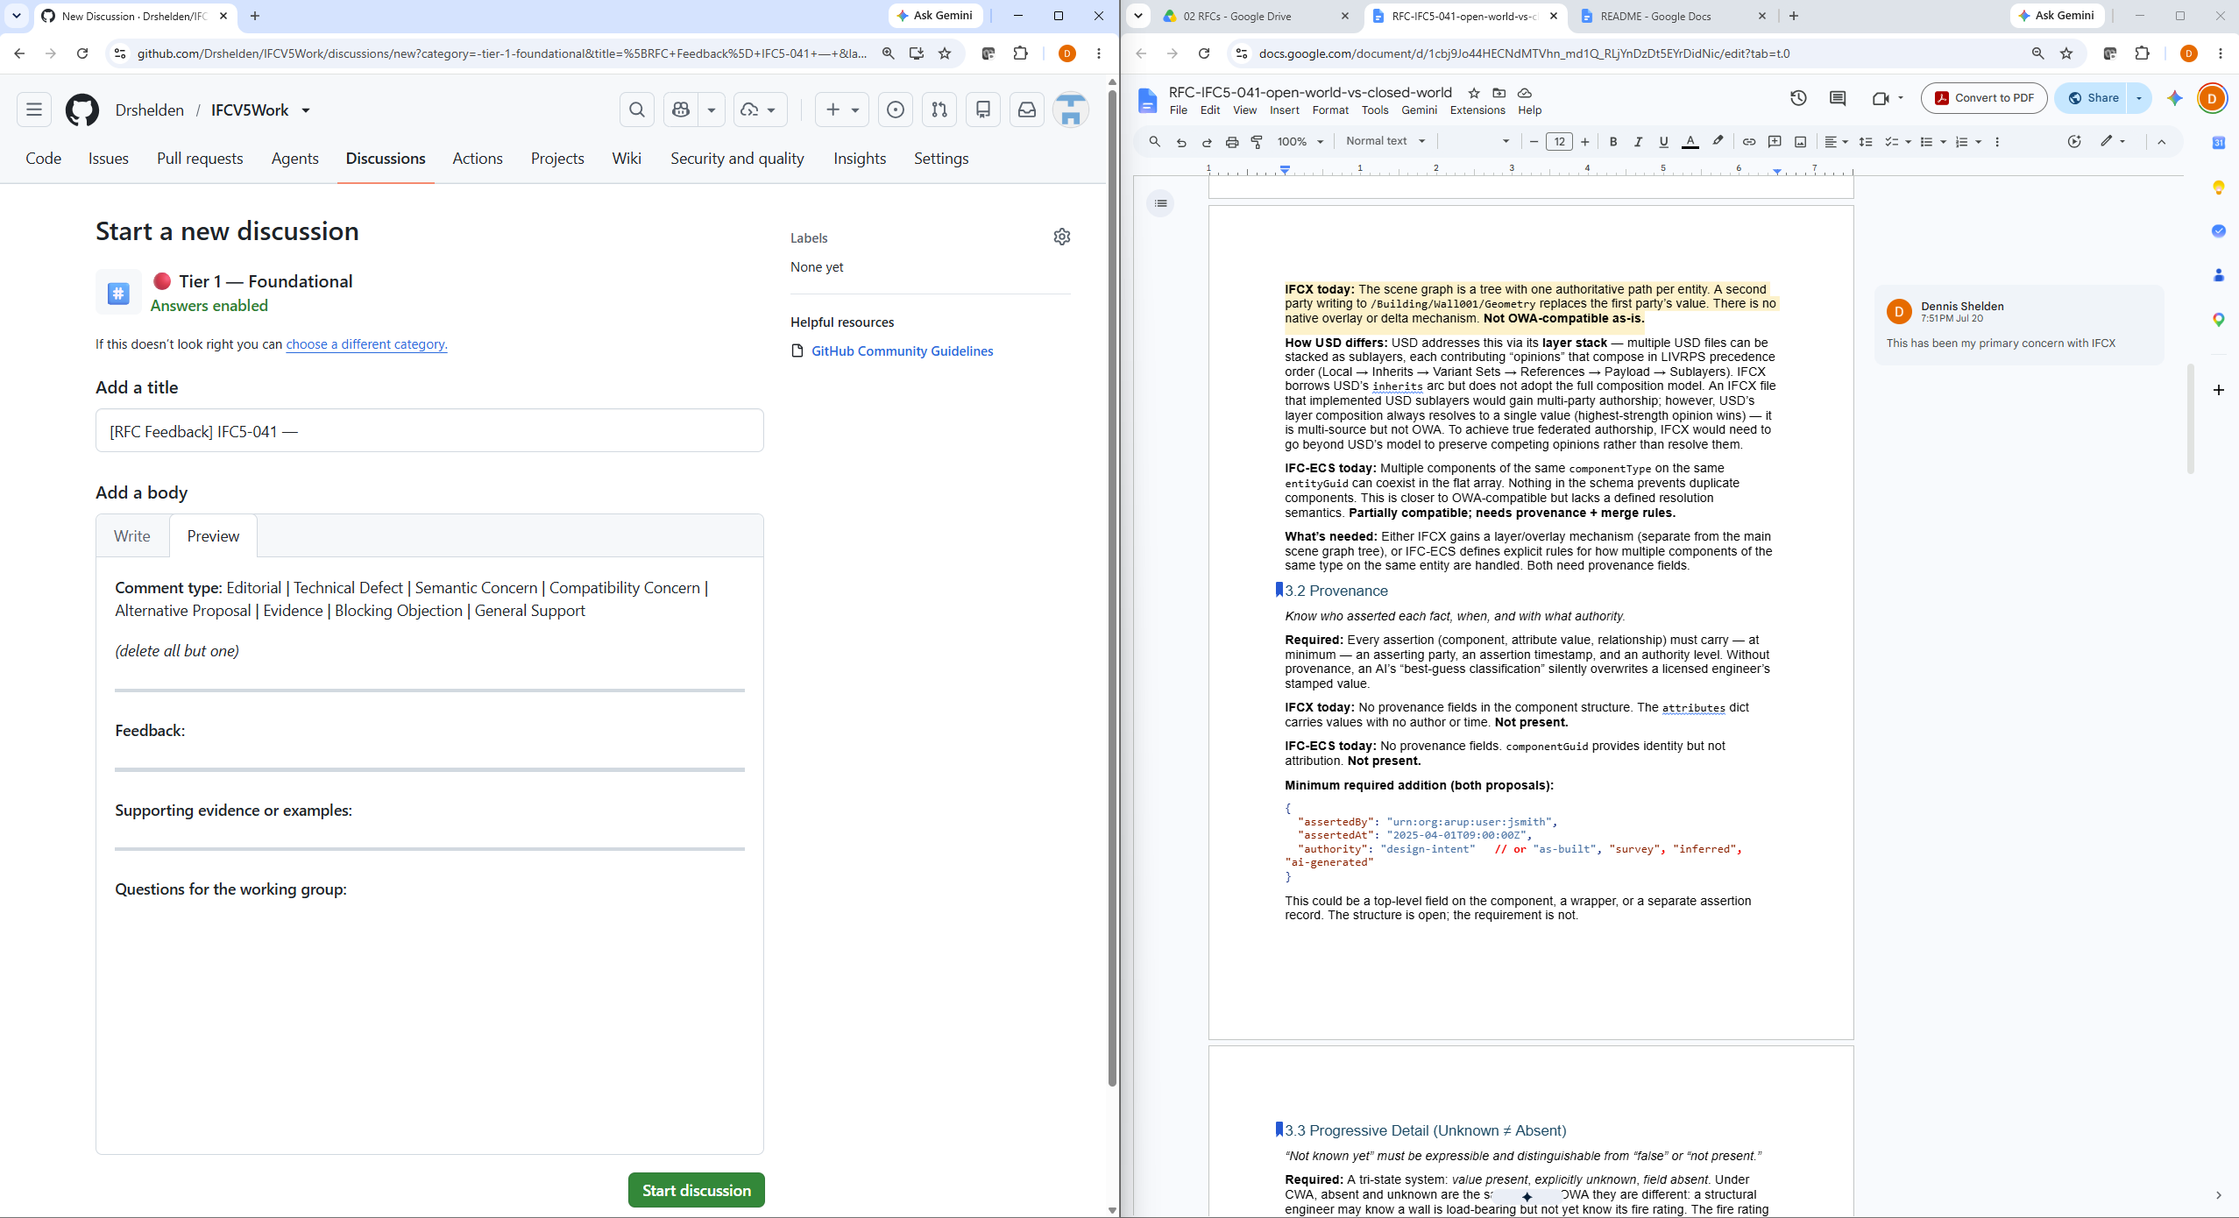

Slide 9
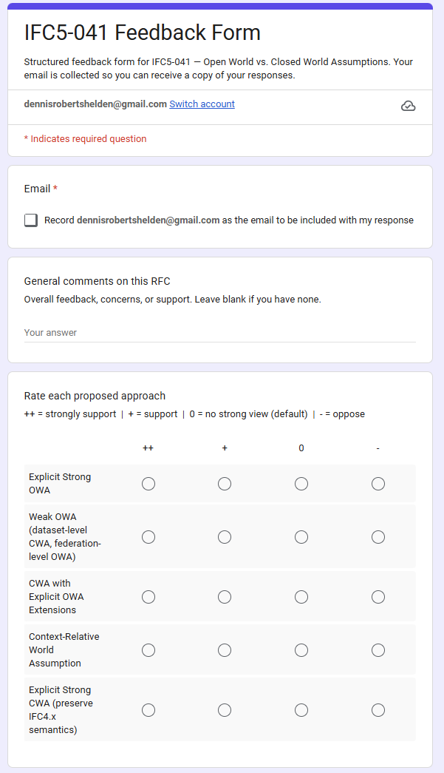
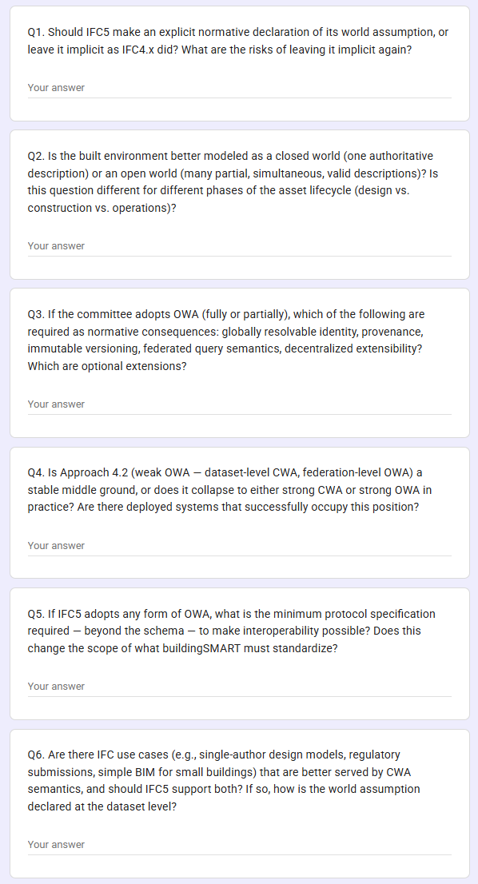

Slide 10
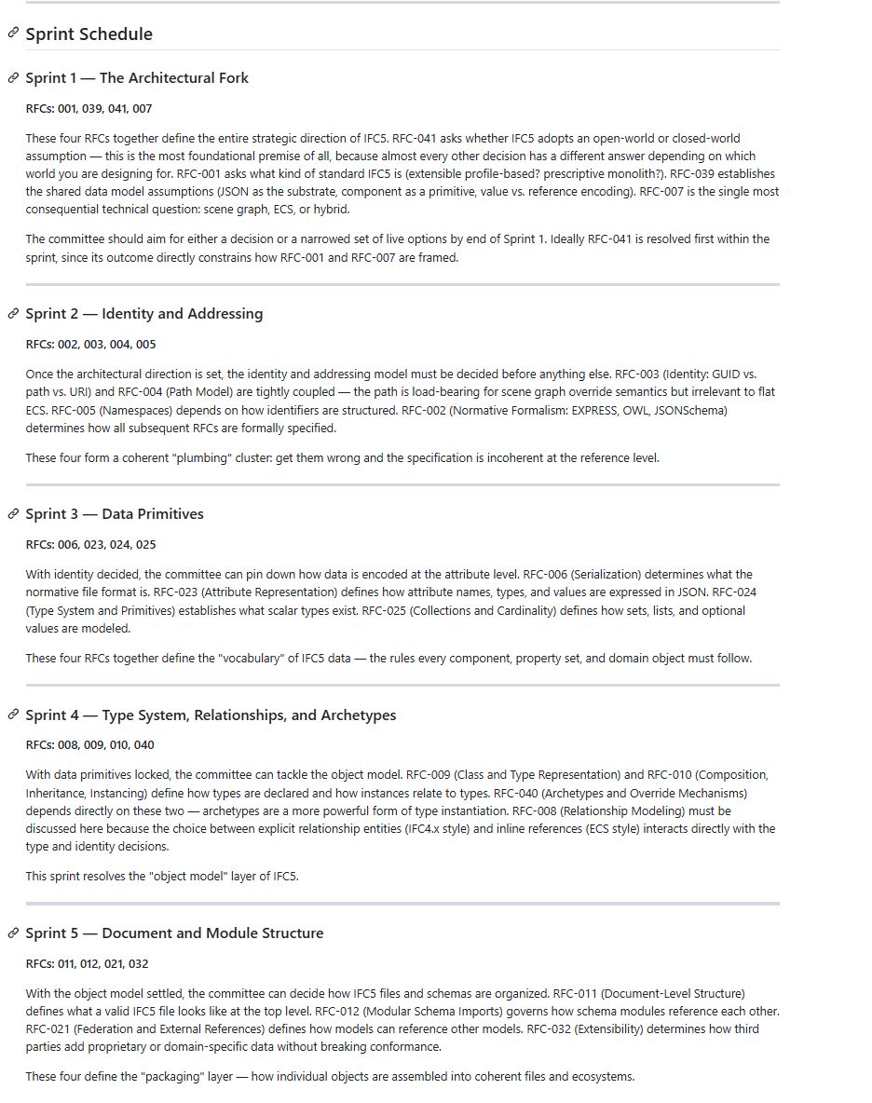
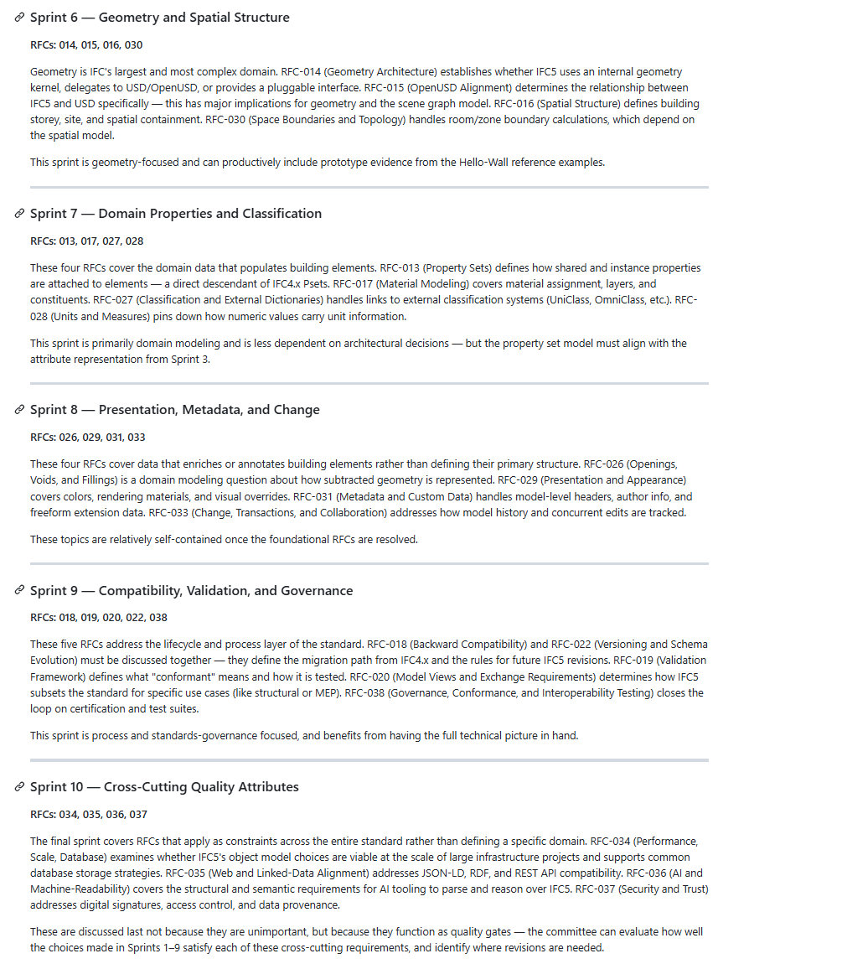

Slide 11
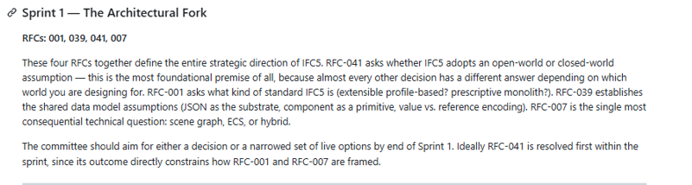
First sprint

Slide 12
Proposed approach
Try first sprint
2 weeks, provide comments in any form (md, doc, form)
Comments are synthesized into consensus and decisions needed.
Final draft of decisions
Move on to next sprint.
Propose more RFCs if needed.
Start here: https://github.com/Drshelden/IFCV5Work (or we can move somewhere else)

